Slide 1
"Метод Micro Learning при обучении написанию задания 38 (эссе по графикам) в ЕГЭ по английскому языку ".
Графинина Светлана Александровна,
учитель английского языка ГБОУ СОШ с.Георгиевка
апрель 2025 г.
РЦ г.Кинель

Slide 2
Микрообучение - это метод, при котором образовательный материал разбивается на части и ученику предоставляется небольшой объем конкретных знаний, который усваивается за короткий промежуток времени. Четкого ограничения формата и времени разъяснения материала нет. Главное - донести основную мысль максимально быстро и понятно.

Slide 3
38.1
Imagine the you are doing a project on popular means of transport in Zetland. You have found some data on the subject – the results of a survey (see the table below).
Comment on the survey data and give your opinion on the subject of the project.
The survey question: What means of transport do you use?
Means of transport | Number of respondents (%)
Bicycle | 55
Car | 15
Bus | 13
Scooter | 10
Motorbike | 7
Write 200-250 words
Use the following plan:
· Make an opening statement on the subject of the project;
· Select and report 2-3 facts;
· Make 1-2 comparisons where relevant and give your comments;
· Outline a problem that one can face using public transport and suggest a way of solving it;
· Conclude by giving and explaining your opinion on the importance of public transport in cities.

Slide 4

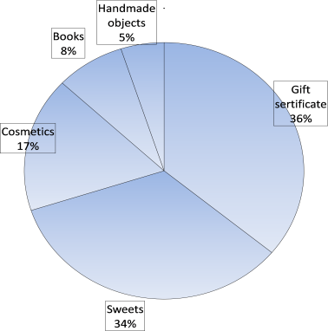
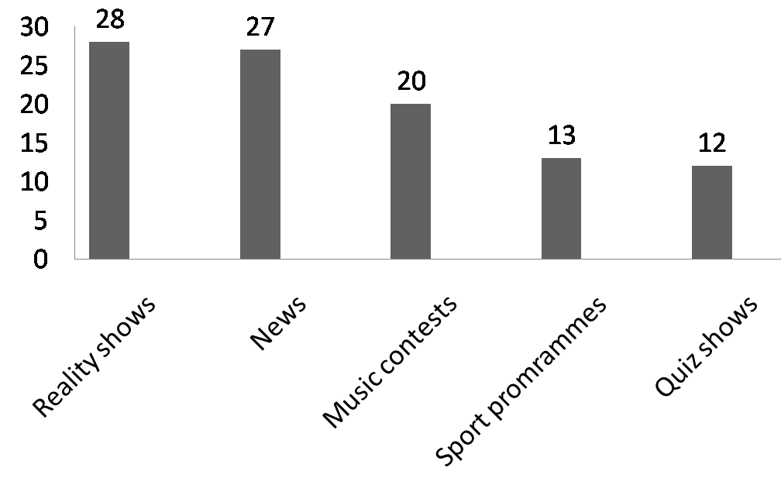
1. - make an opening statement on the subject of the project
Imagine that you are doing a project
on what presents Zetland people
give others for Christmas.
e.g. Nowadays health is a really significant
issue so many people try to keep fit in different ways.
________________________________________ ________________________________________________________________________________
________________________________________ ________________________________________________________________________________
________________________________________ ________________________________________________________________________________
The survey question:
What do you give others for Christmas?
2. - select and report 2-3 facts
Imagine that you are doing a project
on what TV programmes Zetland
people prefer watching.
e.g. According to the table, doing sports and dancing are chosen by the majority of the respondents as ways to keep fit, at 38% and 35% respectively, followed by doing yoga (15%). At the same time, keeping to a diet and walking count much smaller number of supporters, just 7% and 5% respectively.
________________________________________ ________________________________________ ________________________________________ ________________________________________ ________________________________________________________________________________________________________________________
________________________________________ ________________________________________ ________________________________________________________________________________________________________________________________________________________________________________________________________
________________________________________ ________________________________________________________________________________________________________________________________________________________________________________________________________________________________________________
The survey question:
What do you like to watch on TV?
Imagine that you are doing a project
on how Russian students get ready
for exams.
The survey question: How do you prepare for exams?
Ways | Number of respondents (%)
With a tutor | 46
Use notes | 30
Use the Internet | 14
 | 6
With classmates | 4
Make cheat papers

Slide 5
3. Сравни данные, представленные в графиках, с помощью образца.
Imagine that you are doing a project
on what presents Zetland people
give others for Christmas.
- make 1-2 comparisons where relevant and give your comments
The survey question:
What do you give others for Christmas?
e.g. Analysing the data, doing sports appears to be the most prevalent of all responses since more than a third of those interviewed opts for it as a common activity. By contrast, walking is selected by nearly seven times less respondents. I suppose, people in Zetland consider active trainings to be a more effective way to keep fit than more relaxed movements.
________________________________________ ________________________________________ ________________________________________ ________________________________________ ________________________________________________________________________________________________________________________________________________________________________________________________________
________________________________________ ________________________________________ ________________________________________________________________________________________________________________________________________________________________________________________________________________________________________________________________________________________
________________________________________ ________________________________________________________________________________________________________________________________________________________________________________________________________________________________________________________________________________________________________________________________
Imagine that you are doing a project
on what TV programmes Zetland
people prefer watching.
The survey question:
What do you like to watch on TV?
Imagine that you are doing a project
on how Russian students get ready
for exams.
The survey question: How do you prepare for exams?
Ways | Number of respondents (%)
With a tutor | 46
Use notes | 30
Use the Internet | 14
 | 6
With classmates | 4
Make cheat papers

Slide 6

4. Выдвигаем проблему.
4.1. Соотнеси проблемы с данными аспектами.
Considering a problem that can arise with _________________________, I can judge that the majority of people may not have an idea what would suit others best of all, so they give things which are decorative but not practical.
Considering a problem that can arise with _________________________, I can judge that the majority of younger generation does not study diligently during school years, thus they have to memorize much material and their knowledge is unstable.
Considering a problem that can arise with _________________________, I can judge that some people of different ages may lack self-confidence in social situations when others can judge or criticize them for appearance, behaviour or the way they speak.
Considering a problem that can arise with _________________________, I can judge that the majority of high school students increases training and reduces the time for rest which lead to overload and reduced concentration.
Considering a problem that can arise with _________________________, I can judge that some adults may feel stressful when they have to select things for different occasions which can be connected with lack of time or money.
Considering a problem that can arise with _________________________, I can judge that some parents do not approve their children’s mates and try to limit or even prohibit communication with them.
Considering a problem that can arise with _________________________, I can judge that the majority of younger generation feels psychological stress which can be connected with such factors as uncertainty, fear of failure or pressure from adults.
Considering a problem that can arise with _________________________, I can judge that the majority of people considers expensive things to be the way to express the highest appreciation and they get disappointed if they are given small articles.
Considering a problem that can arise with _________________________, I can judge that some people can get offended if their fellows do not call for a meeting for a long time or go somewhere without them.
1. Outline a problem that can arise with meeting with friends.
2. Outline a problem
that can arise with
choosing presents.
3. Outline a problem
that can arise with
getting ready for exams.
Проблема должна быть реальная, а решение – конкретное действие
(не «научиться шить», а «записаться на курсы шитья»)

Slide 7
4.2 Подбери решение к проблемам из задания 4.1.
1.___ To overcome this dilemma, it would be a good idea to set up school courses on time management so that students can build a daily routine and allocate time for training and having a rest.
2.___ To overcome this dilemma, it would be a good idea to make up a creative presentation or a beautiful packaging if a person is going to present not so expensive item in order to make it clear about attention.
3.___ To overcome this dilemma, it would be a good idea to ask the parents what they do not like about the friends, to agree where possible but then to tell about good traits of character of these people and explain that you have your own point of view and you realize all positive and negative sides of these friends.
4.___ To overcome this dilemma, it would be a good idea to try to make notes about the things which a person mentions in conversations as necessary for him so that to be sure that the things will really bring practical benefits and pleasure.
5.___ To overcome this dilemma, it would be a good idea to rehearse the exam situation with the teacher, paying attention to time limit for tasks, and focus on successful achievements rather than negative expectations.
6.___ To overcome this dilemma, it would be a good idea to take up an interesting activity which will help to fill in the time without a friend and spend it with pleasure.
7.___ To overcome this dilemma, it would be a good idea to take a new look at shortcomings and turn them into advantages, for instance, to experiment with appearance, to learn to laugh at yourself in different situations and to treat everything positively.
8.___ To overcome this dilemma, it would be a good idea to begin learning as soon as possible, make an individual training plan and stick to it till the very end.
9.___ To overcome this dilemma, it would be a good idea to prepare gifts in advance by buying universal things such as accessories or purchasing gift certificates.
4.3. Придумай решения к данным проблемам.
Considering a problem that can arise with keeping clean the area people live in, I can judge that at present the majority of residents does not care about littering in the streets which can be connected with the fact that there are few rubbish bins around. To overcome this dilemma, it would be a good idea to __________________________ _____________________________________________________________________________________________________________________________________________.
Considering a problem that can arise with arguing with teachers, I can judge that at present both some of the younger generation and teachers may be rude and tactless to each other which can be connected with unpleasant behaviour or appearance of the two categories of people. To overcome this dilemma, it would be a good idea to _____________________________________________________________________________________________________________________________________________.
Considering a problem that can arise with using public transport, I can judge that at present the majority of passengers faces overcrowding of the buses or route taxis especially at rush hours which makes them travel in uncomfortable conditions. To overcome this dilemma, it would be a good idea to _____________________________ _____________________________________________________________________________________________________________________________________________.

Slide 8
4.4. Впиши недостающую информацию в пропуски.
Considering a problem that can arise with keeping to a diet, I can suggest that the majority of people _______________________________________________________ _____________________________ which can result in _________________________. To overcome this dilemma, it would be a good idea to __________________________ ________________________________________________________________________.
In conclusion, I ___________________ that the importance of keeping to a diet will hardly lose its relevance in people’s lives. It goes without saying, people have an opportunity to ____________________________________________________________.
______________________ that can arise with ________________________________, I can judge that the majority of young people lacks desire to clean their room or help with the housework which ____________________________________ that mothers do everything for them since the childhood. To overcome this dilemma, it ________________________ to make a family schedule for sharing duties and stick to it.
In conclusion, I strongly believe that __________________ of getting used to household chores will hardly _______________________________________________. It goes without saying, teenagers should _____________________________ regularly since it teaches them _____________________________________________________________.
Пишем заключение.

Slide 9

ЗАДАНИЕ 38 (эссе на основе графиков)
Расставь части эссе по порядку в соответствии с планом.
Imagine that you are doing a project on what things Zetland people buy online.
You have found some data on the subject – the results of a survey (see the table below).
Comment on the survey data in the table and give your opinion on the subject of the project.
Write 200-250 words.
Use the following plan:
- make an opening statement on the subject of the project;
- select and report 2-3 facts;
- make 1-2 comparisons where relevant and give your
comments;
- outline a problem that can arise with online shopping and suggest a way of solving it;
- conclude by giving and explaining your opinion on the importance of online shopping in
modern world.
38
Допустимы недобор / превышение количества слов на 10%: 180-275 слов
Абзацы выделяют отступами (красными строками) или широким промежутком между ними (2 клетки)
The survey question: What things do you usually buy online?
Things | Number of respondents (%)
Clothes | 38
Food | 35
Bags | 15
Shoes | 7
Swimsuits | 5
According to the table, clothes and shopping for food are chosen by the majority of the respondents as things to buy online, at 38% and 35% respectively, followed by bags (15%). At the same time shoes and swimsuits count much smaller number of supporters, just 7% and 5% respectively.
In conclusion, I strongly believe that the importance of online shopping will hardly lose its relevance in modern world. It goes without saying, people have an opportunity to find anything they want in the Internet and order things from any part of the world.
Analysing the data, buying clothes in the Internet appears to be the most prevalent of all responses since more than a third of those interviewed opts for them as common items. By contrast, shopping for shoes is selected by nearly seven times less respondents. I suppose, people in Zetland may not be sure in choosing the right sizes of these things online.
Nowadays online shopping is a really significant issue as people tend to buy different items through the Internet. This fact is clearly illustrated in the table with the results of a survey which I found while doing my project on what things Zetland people buy online.
Considering a problem that can arise with online shopping, I can judge that at present the majority of people faces a mismatch of characteristics of goods bought through the Internet which can be connected with the fact that sellers try to present their products in the most attractive way. To overcome this dilemma, it would be a good idea to set up any discounts or points for leaving a detailed review with real photos in order customers could estimate goods.

Slide 10
2. Вставь слова-связки в пропуски.
Nowadays keeping pets is a really …….… issue as people tend to get pets …… different types. This fact is clearly illustrated in the diagram with the results of a survey ………… I found while doing my project on what pets are the most common in Zetland.
…………… to the diagram, cats and dogs are chosen ……….. the majority of the respondents as pets to keep at home, at 40% and 38% ………….., followed by parrots (11%) and fish (8%). ………………… time keeping hamsters counts much smaller number of supporters, just 3%.
…………… the data, cats living at home appear to be the most prevalent ……….. responses since ……………… a third of those interviewed chooses them as common pet animals. …………………, hamsters are selected by ………. thirteen times less respondents. ………………, people in Zetland do not feel affection from hamsters as much as from cats.
Considering a problem that can arise with keeping a pet, I …………………… that at present the majority of people gets a pet ……………… realizing clearly how to take care of it properly which can be ………………… the fact that they admire little beings ………………… forget that pets should be treated in special ways. ……………………… this dilemma, it would be a good idea to set up a special certificate for any pet owner which means going through courses on grooming pets.
……………………., I strongly believe that the importance of having pets will hardly lose its relevance in people’s lives. It goes without ………………, pets are stress relievers, they teach us responsibility and affection, create cosy atmosphere at home.
nearly significant however analysing according
can judge in conclusion of all more than of
without saying by contrast at the same by
which to overcome connected with respectively I suppose
Категория людей, упоминаемая в эссе, должна соответствовать категории опрошенных (people, teenagers, children).
Первые три абзаца касаются именно графика (т.е. только опрошенных из указанной страны), два последних абзаца – о проблеме в целом (которая может возникнуть у любого человека).
Вводные фразы отделяются запятыми.

Slide 11
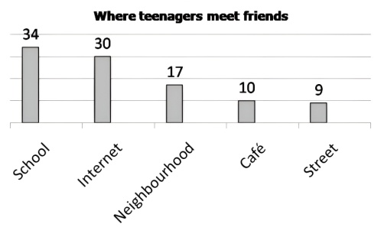
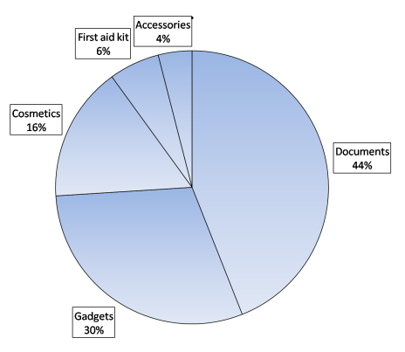
3. Найди по 5 ошибок в каждом отрывке.
Friendship between people is an important part of their lives so they tend to find friends in different ways. While doing my essay on “where teenagers in Russia meet friends” I relied on the diagram with some data on the subject.
Imagine that you are doing a
project on where Russian
teenagers meet friends. You
have found some data on the
subject – the results of a survey
(see the diagram below).
Comment on the survey
data in the diagram and give
your opinion on the subject of
the project.
According to the table, the majority of respondents chooses school as the place to get acquainted with peers which comprises 34% as well as the Internet which makes up 30%. At the same time, cafes and streets as places to meet future friends count much higher number of supporters, just 9% and 10% respectively. In addition, 17% of the people responded opts for neighbourhood as the spot for acquaintance.
The survey question: Where do you meet new friends?
Looking at the data, schools appear to be the most prevalent of all responses as almost a half of those interviewed opts for them as a common place of meeting. By chance, streets tend to be the least popular since almost four times less respondents have referred to them. Perhaps, children in Russia prefer to find friends in the place which takes much time of their lives.
Imagine that you are doing a
project on what things Zetland
people take mainly to the trip .
You have found some data on the
subject – the results of a survey
(see the pie chart below).
Comment on the survey data
in the pie chart and give your
opinion on the subject of the
project.
Travelling has become an essential part of modern life. When packing things for a trip, children tend to take items of different sizes. I decided to make a project on “what things people in Zetland take mainly to the trip” and I found a pie chart with some data for analysing.
In addition to the pie chart, documents and gadgets are chosen by the minority of the respondents as things to take mainly to the trip, at
The survey question: What do you take to the trip first of all?
44% and 30%, following by cosmetics (16%). Whereas first aid kit and accessories count much smaller number of supporters, just 4% and 6% respectively.
Analysing the project, documents appear to be the most demanded objects in trips while almost a quarter of those interviewed opts for them. By contrast, accessories are mentioned by eleven times less respondents. I suppose identity documents are more important for people in Russia than things to decorate themselves with.

Slide 12
9. Впиши недостающую информацию в пропуски.
Considering a problem that can arise with keeping to a diet, I can suggest that the majority of people _______________________________________________________ _____________________________ which can result in _________________________. To overcome this dilemma, it would be a good idea to __________________________ ________________________________________________________________________.
In conclusion, I ___________________ that the importance of keeping to a diet will hardly lose its relevance in people’s lives. It goes without saying, people have an opportunity to ____________________________________________________________.
______________________ that can arise with ________________________________, I can judge that the majority of young people lacks desire to clean their room or help with the housework which ____________________________________ that mothers do everything for them since the childhood. To overcome this dilemma, it ________________________ to make a family schedule for sharing duties and stick to it.
In conclusion, I strongly believe that __________________ of getting used to household chores will hardly _______________________________________________. It goes without saying, teenagers should _____________________________ regularly since it teaches them _____________________________________________________________.
10. Напиши эссе на основе графика.
Imagine that you are doing a project on why Zetland teenagers go to the parties. You have found some data on the subject – the results of a survey (see the table below). Comment on the survey data in the table and give your opinion on the subject of the project.
Write 200-250 words.
Use the following plan:
- make an opening statement on the subject of the
project;
- select and report 2-3 facts;
- make 1-2 comparisons where relevant and give your comments;
- outline a problem that can arise with visiting parties and suggest a way of solving it;
- conclude by giving and explaining your opinion on the importance of having a rest in
teenagers’ lives.
38
The survey question: Why do you go to the parties?
Reasons | Number of respondents (%)
To feel independent | 37
To feel a part of a company | 24
To find a girlfriend/boyfriend | 20
To meet peers | 10
To dance and have fun | 9
Стиль эссе – нейтральный (без-эмоциональный):
полные формы (do not like). Исключение - needn’t
отсутствует сниженная лексика: сленг и разговорные слова (hang out, jump in, crush on sb, Let’s, ‘cos, bro, dude) (в словаре: informal, inf. – неформальный стиль), идиомы (at all costs, to rain cats and dogs)
отсутствуют риторические вопросы и восклицания
избегаем широкое обобщение (all people like rock music), используем гипотетические высказывания (people may like rock music)

Slide 13

РЕФЛЕКСИЯ
О чем важно помнить при написании эссе?
Количество слов
Абзацы
Вводные фразы
Категория людей, страна, тема проекта
Проблема + решение
Грамматика
Стиль эссе, лексика
Оцени, насколько тебе стало понятно, каким образом писать эссе на основе графиков.
Я отлично понял, как писать эссе, обучающие задания мне помогли. Я доволен своими результатами.
Я понял все аспекты, но некоторые задания вызвали у меня затруднения. Я жду дальнейшей практики, чтобы улучшить результаты.
Я не понял многие аспекты. Мне было трудно выполнять задания. Я хотел бы разобрать тему еще раз.

Slide 14
ШАБЛОН ЭССЕ НА ОСНОВЕ ГРАФИКА
Nowadays … (объект из темы) is a really significant issue as people (children, teenagers) tend to… (глаг+сущ) in different ways ( ). This fact is
clearly illustrated in the with the results of a survey which I found while doing my project on… (тема проекта)
According to the , … (строчка1: сущ или Ving) (and строчка2: сущ
или Ving) is (are) chosen by the majority of the respondents as … (things, ways, reasons) to … (глагол из вопроса в таблице/диаграмме), at …% (and …% respectively), followed by … (средние показатели: сущ или Ving) (…%) (and … (…%)). At the same time, … (1-2 нижних строчки: сущ или Ving) count(s) much smaller number of supporters, just …% (and…% respectively).
Analysing the data, … (строчка 1: сущ или Ving) appear(s) to be the most prevalent of all responses as of those interviewed opts for it(them) as a
common . By contrast, …(строчка 5: сущ или Ving) is (are)
selected by nearly less respondents. I suppose, … is more important (captivating,
effective) for people (children, teenagers) in Zetland than …
Considering a problem that can arise with … (см. п.4 в плане), I can judge that younger (elder) generation may face / lack … which can result in … / can lead to… To overcome this dilemma, it would be a good idea to (set up school courses on …)
In conclusion, I strongly believe that the importance of … (см. п.5 в плане) will hardly lose its relevance in people’s (teenagers’) lives. It goes without saying,
… has (have) a positive impact on … (the environment, progress in studies, physical/mental development, health)
или
teenagers/people have an opportunity to …
-10-

Slide 15
ANSWERS
1.
Nowadays online shopping is a really significant issue as people tend to buy different items through the Internet. This fact is clearly illustrated in the table with the results of a survey which I found while doing my project on what things Zetland people buy online.
According to the table, clothes and shopping for food are chosen by the majority of the respondents as things to buy online, at 38% and 35% respectively, followed by bags (15%). At the same time, shoes and swimsuits count much smaller number of supporters, just 7% and 5% respectively.
Analysing the data, buying clothes in the Internet appears to be the most prevalent of all responses since more than a third of those interviewed opts for them as commom items. By contrast, shopping for shoes and swimsuits is selected by nearly seven times less respondents. I suppose, people in Zetland may not be sure in choosing the right sizes of these things online.
Considering a problem that can arise with online shopping, I can judge that at present the majority of people faces a mismatch of characteristics of goods bought through the Internet which can be connected with the fact that sellers try to present their products in the most attractive way. To overcome this dilemma, it would be a good idea to set up any discounts or points for leaving a detailed review with real photos in order customers could estimate goods.
In conclusion, I strongly believe that the importance of online shopping will hardly lose its relevance in modern world. It goes without saying, people have an opportunity to find anything they want in the Internet and order things from any part of the world.
2. Nowadays keeping pets is a really significant issue as people tend to get pets of different types. This fact is clearly illustrated in the diagram with the results of a survey which I found while doing my project on what pets are the most common in Zetland.
According to the diagram, cats and dogs are chosen by the majority of the respondents as pets to keep at home, at 40% and 38% respectively, followed by parrots (11%) and fish (8%). At the same, time keeping hamsters counts much smaller number of supporters, just 3%.
Analysing the data, cats living at home appear to be the most prevalent of all responses since more than a third of those interviewed chooses them as common pet animals. By contrast, hamsters are selected by nearly thirteen times less respondents. I suppose people in Zetland do not feel affection from hamsters as much as from cats.
Considering a problem that can arise with keeping a pet, I can judge that at present the majority of people gets a pet without realizing clearly how to take care of it properly which can be connected with the fact that they admire little beings, however, forget that pets should be treated in special ways. To overcome this dilemma, it would be a good idea to set up a special certificate for any pet owner which means going through courses on grooming pets.
In conclusion, I strongly believe that the importance of having pets will hardly lose its relevance in people’s lives. It goes without saying, pets are stress relievers, they teach us responsibility and affection, create cosy atmosphere at home.
-11-

Slide 16
3.
Friendship between teenagers is an important part of their lives so they tend to find friends in different places. While doing my project on _where teenagers in Russia meet friends_ I relied on the diagram with the results of a survey.
According to the diagram, the majority of the respondents chooses school as the place to get acquainted with peers which comprises 34% as well as the Internet which makes up 30%. At the same time, cafes and streets as places to meet future friends count much smaller number of supporters, just 10% and 9% respectively. In addition, 17% of the teenagers responded opts for neighbourhood as the spot for acquaintance.
Analysing the data, schools appear to be the most prevalent of all responses as almost a third of those interviewed opts for them as a common place of meeting. By contrast, streets tend to be the least popular since almost three times less respondents have referred to them. Perhaps, teenagers in Russia prefer to find friends in the place which takes much time of their lives.
Travelling has become an essential part of modern life. When packing things for a trip, people tend to take items of different types. I decided to do a project on _what things Zetland people take mainly to the trip_ and I found a pie chart with the results of a survey for analysing.
According to the pie chart, documents and gadgets are chosen by the majority of the respondents as things to take mainly to the trip, at 44% and 30% respectively, followed by cosmetics (16%). Whereas first aid kit and accessories count much smaller number of supporters, just 6% and 4% respectively.
Analysing the data, documents appear to be the most demanded objects in trips since almost a half of those interviewed opts for them. By contrast, accessories are selected by eleven times less respondents. I suppose identity documents are more important for people in Zetland than things to decorate themselves with.
4.
- make an opening statement on the subject of the project
Nowadays giving gifts is a really significant issue as many people in Zetland give presents of different types to each other for Christmas.
Nowadays watching TV is a really significant issue as many people in Zetland watch programmes of different types on TV.
Nowadays passing exams is a really significant issue so many students in Russia study for exams in different ways.
- select and report 2-3 facts
According to the pie chart, gift certificates and sweets are chosen by the majority of the respondents as things to give others for Christmas, at 36% and 34% respectively, followed by giving cosmetics (17%). At the same time, books and handmade objects count much smaller number of supporters, just 8% and 5% respectively.
According to the diagram, reality shows and news are chosen by the majority of the respondents as TV programmes to enjoy, at 28% and 27% respectively, followed by getting pleasure from music contests (20%). At the same time, sport programmes and quiz shows count much smaller number of supporters, just 13% and 12% respectively.
According to the table, preparing for exams with a tutor and using notes are chosen by the majority of the respondents as ways to prepare for exams, at 46% and 30% respectively, followed by using the Internet (14%). At the same time, making cheat papers and studying with classmates count much smaller number of supporters, just 6% and 4% respectively.
-12-

Slide 17
5.
- make 1-2 comparisons where relevant and give your comments
1. Analysing the data, gift certificates appear to be the most prevalent of all responses since more than a third of those interviewed opts for them as common presents for Christmas. By contrast, handmade objects are selected by seven times less respondents. I suppose, people in Zetland tend to give universal gifts which can be appreciated by anyone.
2. Analysing the data, reality shows appear to be the most prevalent of all responses since more than a quarter of those interviewed opts for them as common programmes. By contrast, quiz shows are selected by nearly twice less respondents. I suppose, people in Zetland consider programmes about real lives of people to be more captivating than intellectual ones.
3. Analysing the data, preparing for exams with a tutor appears to be the most prevalent of all responses as almost a half of those interviewed opts for it as a common way to get ready. By contrast, studying with classmates is selected by eleven times less respondents. I suppose, having lessons with a professional is more effective for students in Russia than with peers.
6. a. choosing presents f. meeting with friends
b. getting ready for exams g. getting ready for exams
c. meeting with friends h. choosing presents
d. getting ready for exams i. meeting with friends
e. choosing presents
7.
d
h
f
a
g
i
c
b
e
8. Примеры ответов.
To overcome this dilemma it would be a good idea to set up rubbish bins every 10 metres and of different types in order people to sort it when throwing away.
To overcome this dilemma it would be a good idea to set up psychological courses for younger and elder generations on dealing with tolerance and accepting other people’s point of view.
To overcome this dilemma it would be a good idea to create a unified traffic schedule by the government of a city and implement it among public transport drivers.
-13-

Slide 18
9. Примеры ответов.
Considering a problem that can arise with keeping to a diet, I can suggest that the majority of people refuse to eat meat or other useful products which can result in unbalanced nutrition and harm to the body. To overcome this dilemma it would be a good idea to contact a competent nutritionist to make a personal diet.
In conclusion, I strongly believe that the importance of keeping to a diet will hardly lose its relevance in people’s lives. It goes without saying, people have an opportunity to clean the organism, get useful elements and improve appearance.
Considering a problem that can arise with performing household duties, I can judge that the majority of young people lacks desire to clean their room or help with the housework which can be connected with the fact that mothers do everything for them since the childhood. To overcome this dilemma it would be a good idea to make a family schedule for sharing duties and stick to it.
In conclusion, I strongly believe that the importance of getting used to household chores will hardly lose its relevance in people’s lives. It goes without saying, teenagers should help about the house regularly since it teaches them responsibility and gives useful skills for future independent living.
10. Пример ответа.
Nowadays informal events are a really significant issue as teenagers tend to visit parties
for different reasons. This fact is illustrated in the table with the results of a survey which I
found for doing my project on why Zetland teenagers go to the parties.
According to the table, feeling independent is chosen by the majority of the respondents (37%)
as a reason to go to the party, followed by feeling a part of a company (24%) and finding a
girlfriend/boyfriend (20%). At the same time meeting peers and dancing and having fun count much
smaller number of supporters, just 10% and 9% respectively.
Analysing the data, feeling independent appears to be the most prevalent of all responses since
more than a third of those interviewed opts for it as a common reason. By contrast, dancing and
having fun are selected by nearly three times less respondents. I suppose, teenagers in Zetland
consider parties to be more important for social life than for relaxation.
Considering a problem that can arise with visiting parties, I can judge that the majority of
younger generation lacks self-confidence and feels uncomfortable at parties as a result of the
comparison themselves with other peers who are more easy-going. To overcome this dilemma it
would be a good idea to try on a festive image in advance since a person takes much confidence if he
knows he looks perfect.
In conclusion, I strongly believe that the importance of having a rest will hardly lose its
relevance in teenagers’ lives. It goes without saying, young people can take a break from studies,
establish new contacts and strengthen the old ones. (265 words)
-14-

